Slide 1
Trends in Gaming
And how the Pandemic affected them

Slide 2
Focus of This study
Big Data Analysis of:
Games sold
Hours played
Number/density of player base
Group trends in different categories of games
Price
Etcetera

Slide 3
Current SOurces
Steam Databases
Yahoo Finance

Slide 4
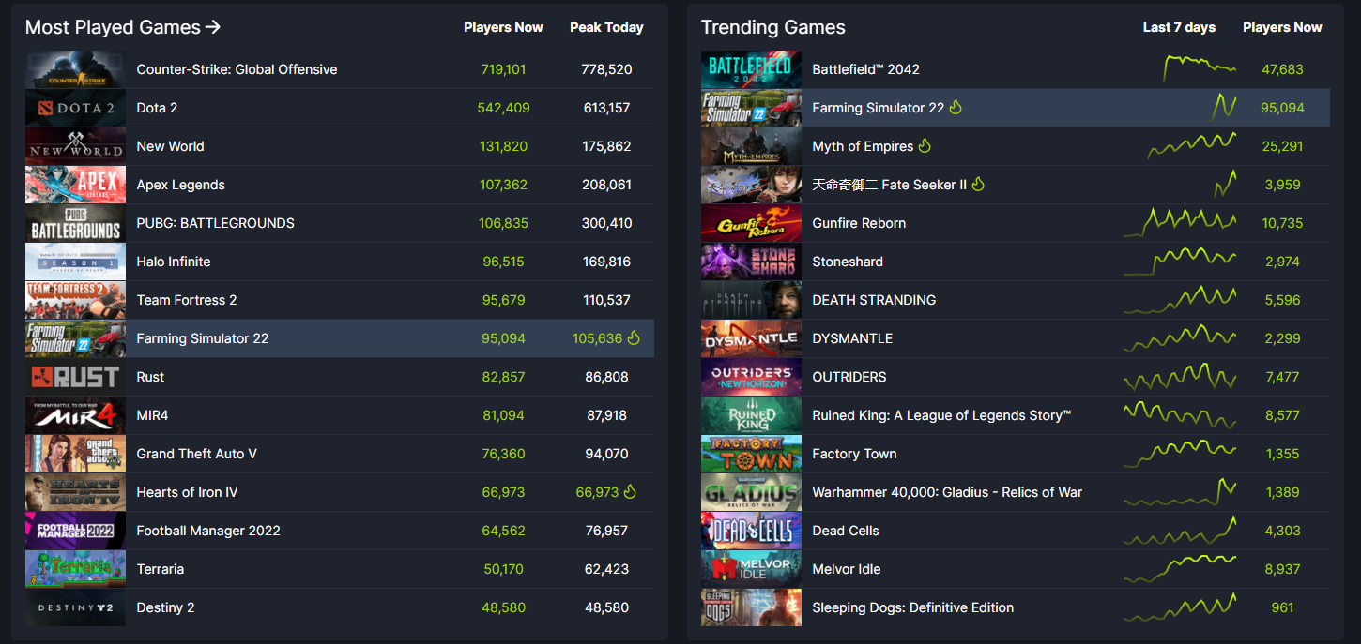

Slide 5
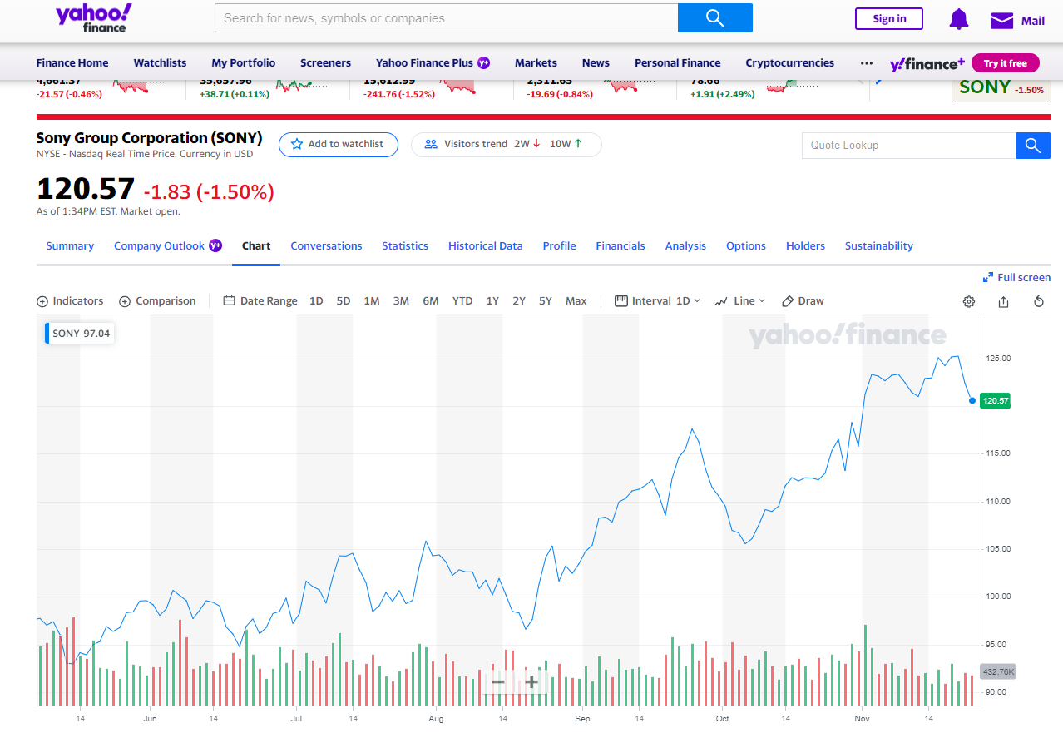

Slide 6
Applications of this Project
Game designers
Marketing
Population studies
Gender studies

